Slide 1
Advanced Node.js, TypeScript API Development Course: Building a Robust Inventory Management System with POS

Slide 2
Welcome to this advanced course where we will build a powerful API for an Inventory Management System with a Point of Sale (POS) using Node.js, TypeScript, Express, MongoDB, and Prisma.
This course is designed for developers who want to deepen their understanding of backend development using TypeScript and Node.js, and it will guide you through building a production-ready API that you can use in real-world applications.
The API we will build is intended for a client managing multiple drug shops, requiring comprehensive features like user roles, shop management, and extensive product relationships.

Slide 3
What We Will Build:
In this course, we will create an API that supports the following functionalities:
Authentication and Authorization: Implementing a robust system where the admin can log in, create shop attendants, and manage user roles and permissions.
Shop Management: Allowing the admin to create and manage multiple shops.
Product Management: Admin can create products with complex relationships, including categories, manufacturers, product families, industries, and units.
Customer and Sales Tracking: Features to track customers, sales, and orders, providing a comprehensive overview of shop performance.

Slide 4
Course Outline:
Introduction & Setup
Overview of the project
Setting up the development environment
Installing Node.js, TypeScript, and Express
Initializing a new Node.js project
Setting Up TypeScript & Express
Configuring TypeScript in a Node.js project
Setting up Express with TypeScript
Creating basic route handlers
Handling errors and middlewares
Integrating Prisma with MongoDB
Setting up Prisma in a Node.js project
Configuring MongoDB as the database
Defining the Prisma schema
Running migrations and seeding the database
Building Authentication & Authorization
Implementing JWT for authentication
Setting up roles and permissions
Creating middleware for role-based access control
Building routes for user registration, login, and role management

Slide 5
Shop Management Module
Creating the Shop model in Prisma
Building routes for shop creation and management
Associating shops with users (admin and attendants)
Implementing CRUD operations for shops
Product Management Module
Defining the Product model with relationships (category, manufacturer, etc.)
Building routes for creating and managing products
Implementing filters and search functionality for products
Managing product inventory and stock levels
Customer & Sales Tracking Module
Creating models for customers, sales, and orders
Building routes for managing customers
Implementing order processing and sales tracking
Generating reports and summaries for shop performance
Testing & Deploying the API
Writing unit and integration tests for the API
Setting up CI/CD for continuous deployment
Deploying the API to a production environment (e.g., Railway)
Monitoring and logging API performance
Future Extensions
Overview of building a React Native app to consume the API
Planning for future updates and feature enhancements

Slide 6
INVENTORY MANAGEMNT SYSTEM
API
User Management
Suppliers Management
Customer Management
Shop Management
Product Management
Point of Sale
Expenses Management
Employee Management
Roles and Permissions
Reports
Customer Credit Management
Login
Category
Unit Mgt
Brand
Sales
SaleItem
Forgot Password
Verify-token
Change Password
Stock Alerts
Stock Purchase
Stock Adjustment

Slide 7
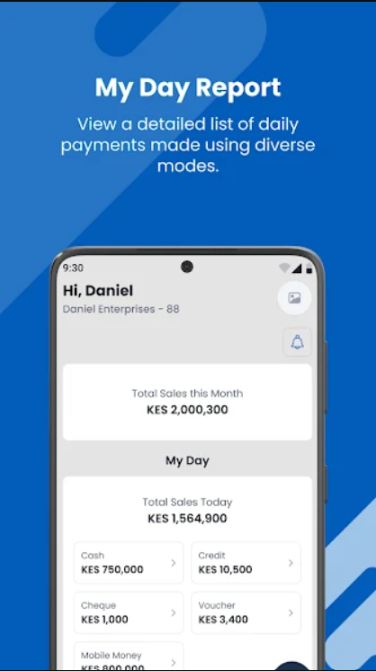

Slide 8
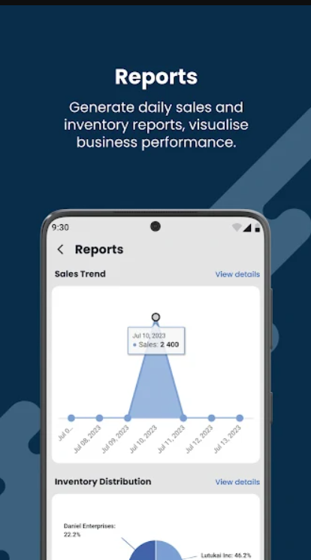

Slide 9
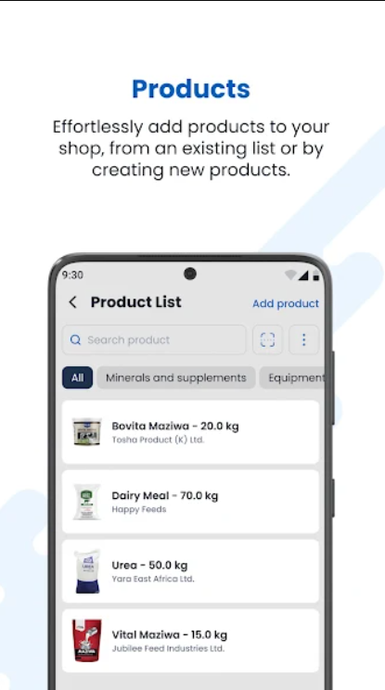

Slide 10
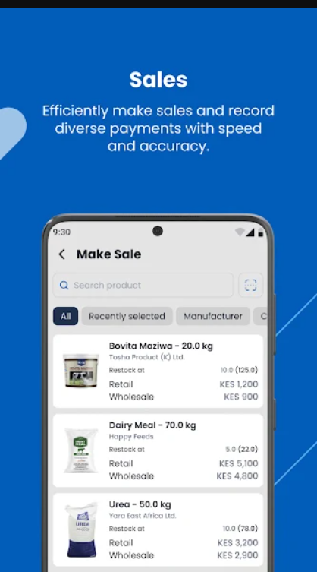

Slide 11
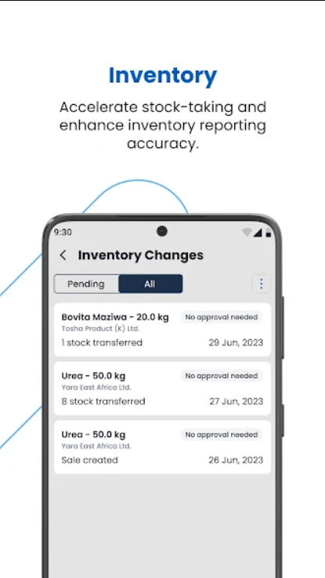

Slide 12
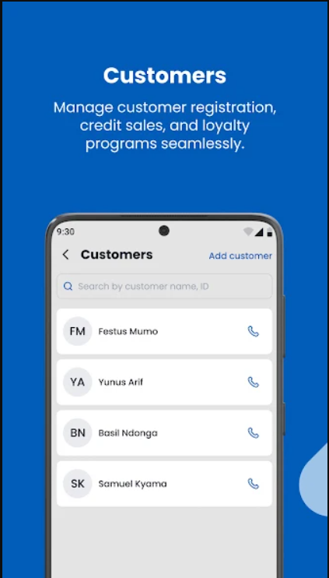

Slide 13
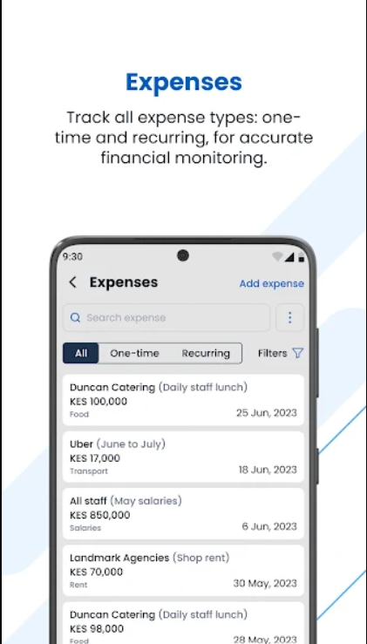

Slide 14
SHOP OWNER

Slide 15
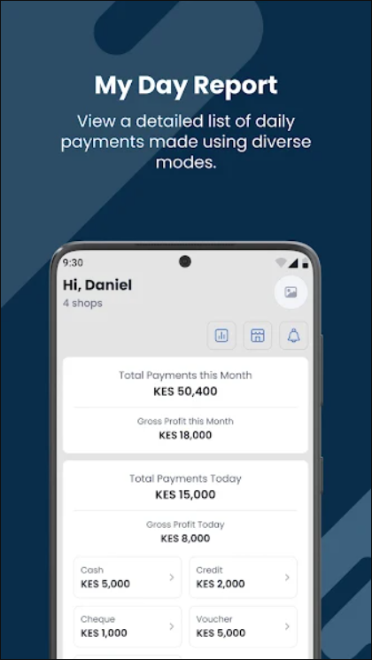

Slide 17
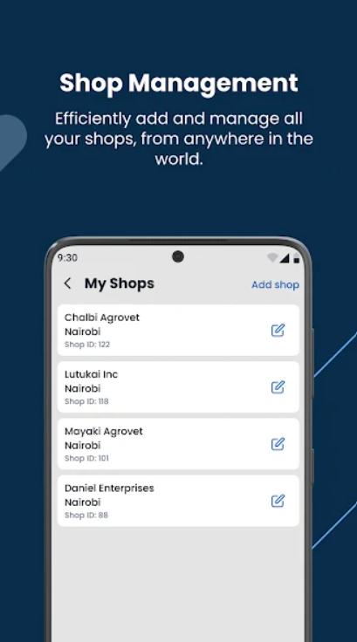

Slide 18
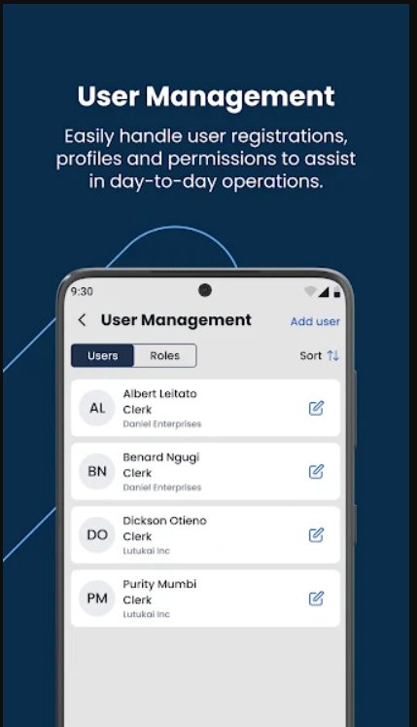

Slide 19
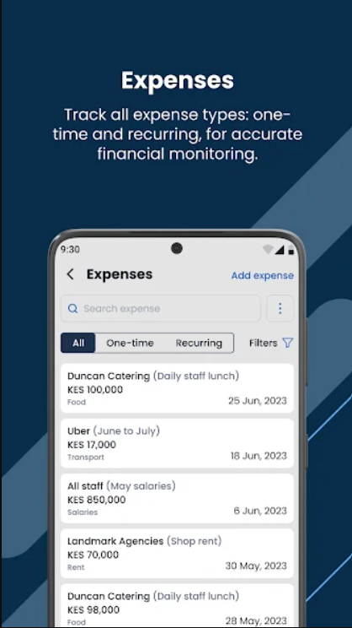

Slide 20
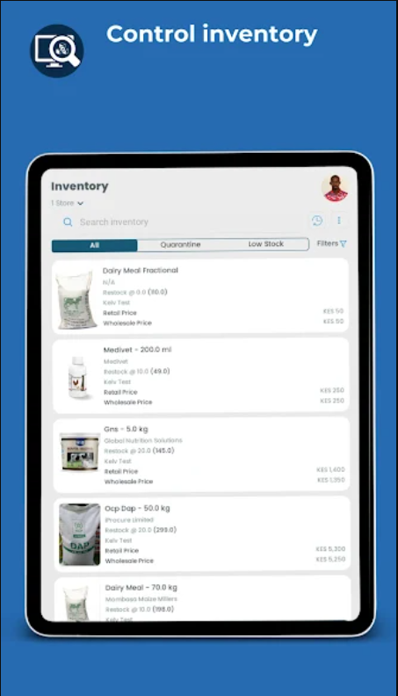

Slide 21
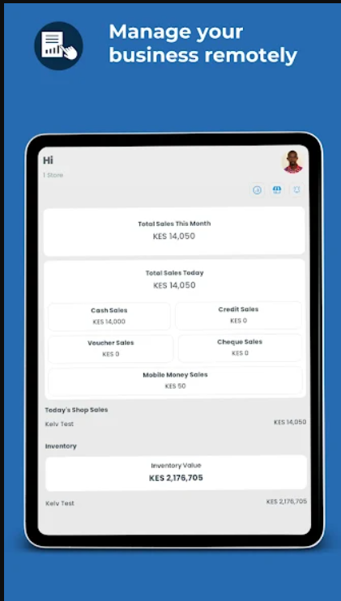

Slide 22
USER AND SHOP MANAGEMENT
Shape - Fields (Get these from a form)
Relationships (Dropdowns /Selections in forms)

Slide 23
USER AND A SHOP
One-to-Many Relationship
User as Admin:
A User can be an Admin of multiple Shops. This means that a single user, when assigned the role of ADMIN, has the ability to manage more than one shop.The relationship is represented by the admin field in the Shop model. Each shop has an adminId which is a foreign key linking it to a specific user (the admin).In Prisma, this is implemented as a one-to-many relationship, where one user (admin) can be associated with multiple shops.
User as Attendant:
A User can also be an Attendant in a shop. Attendants work in shops created by the admin.This is represented by the attendants field in the Shop model, where the shop can have multiple attendants.

Slide 24
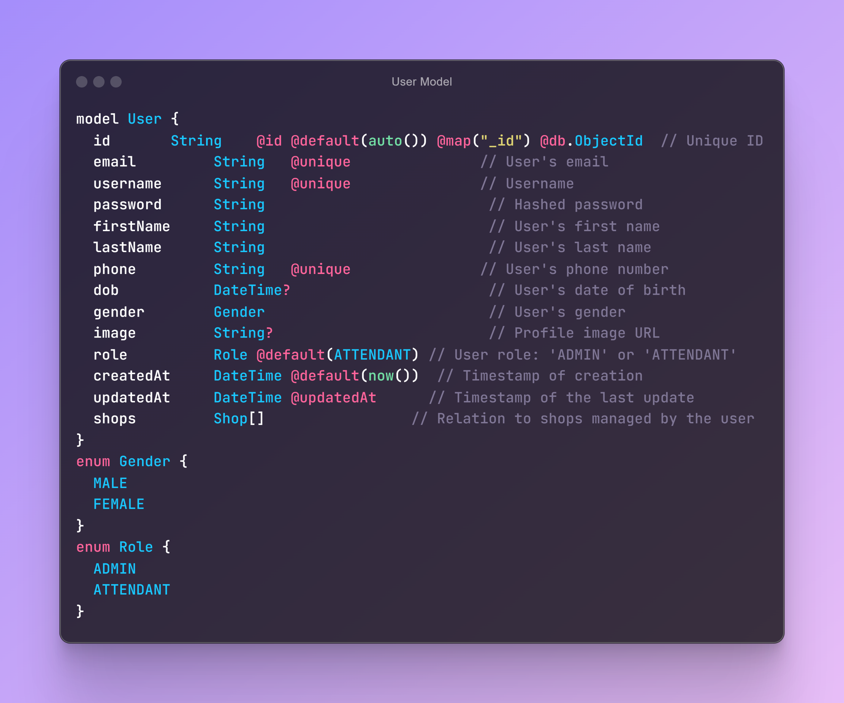
USER MODEL

Slide 25
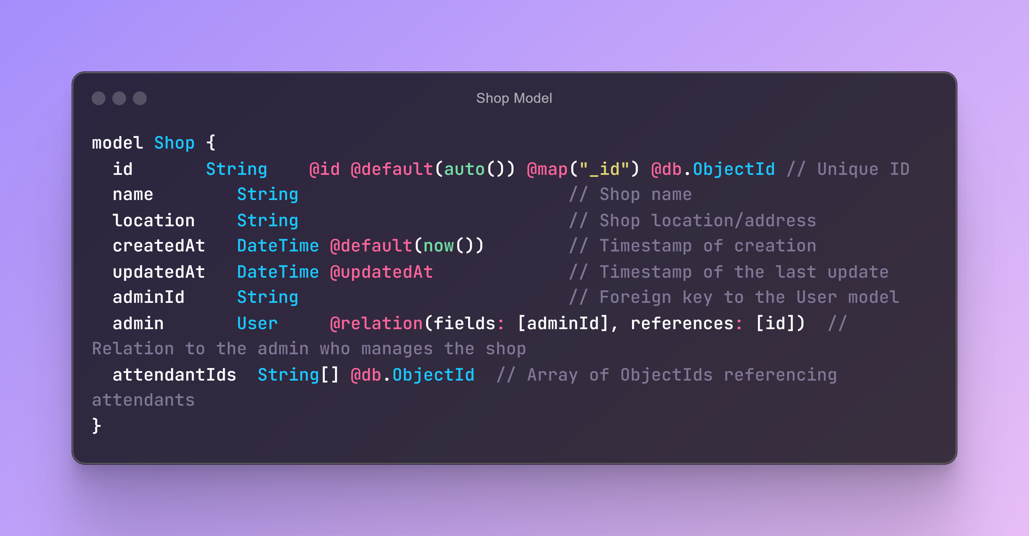
SHOP MODEL

Slide 26
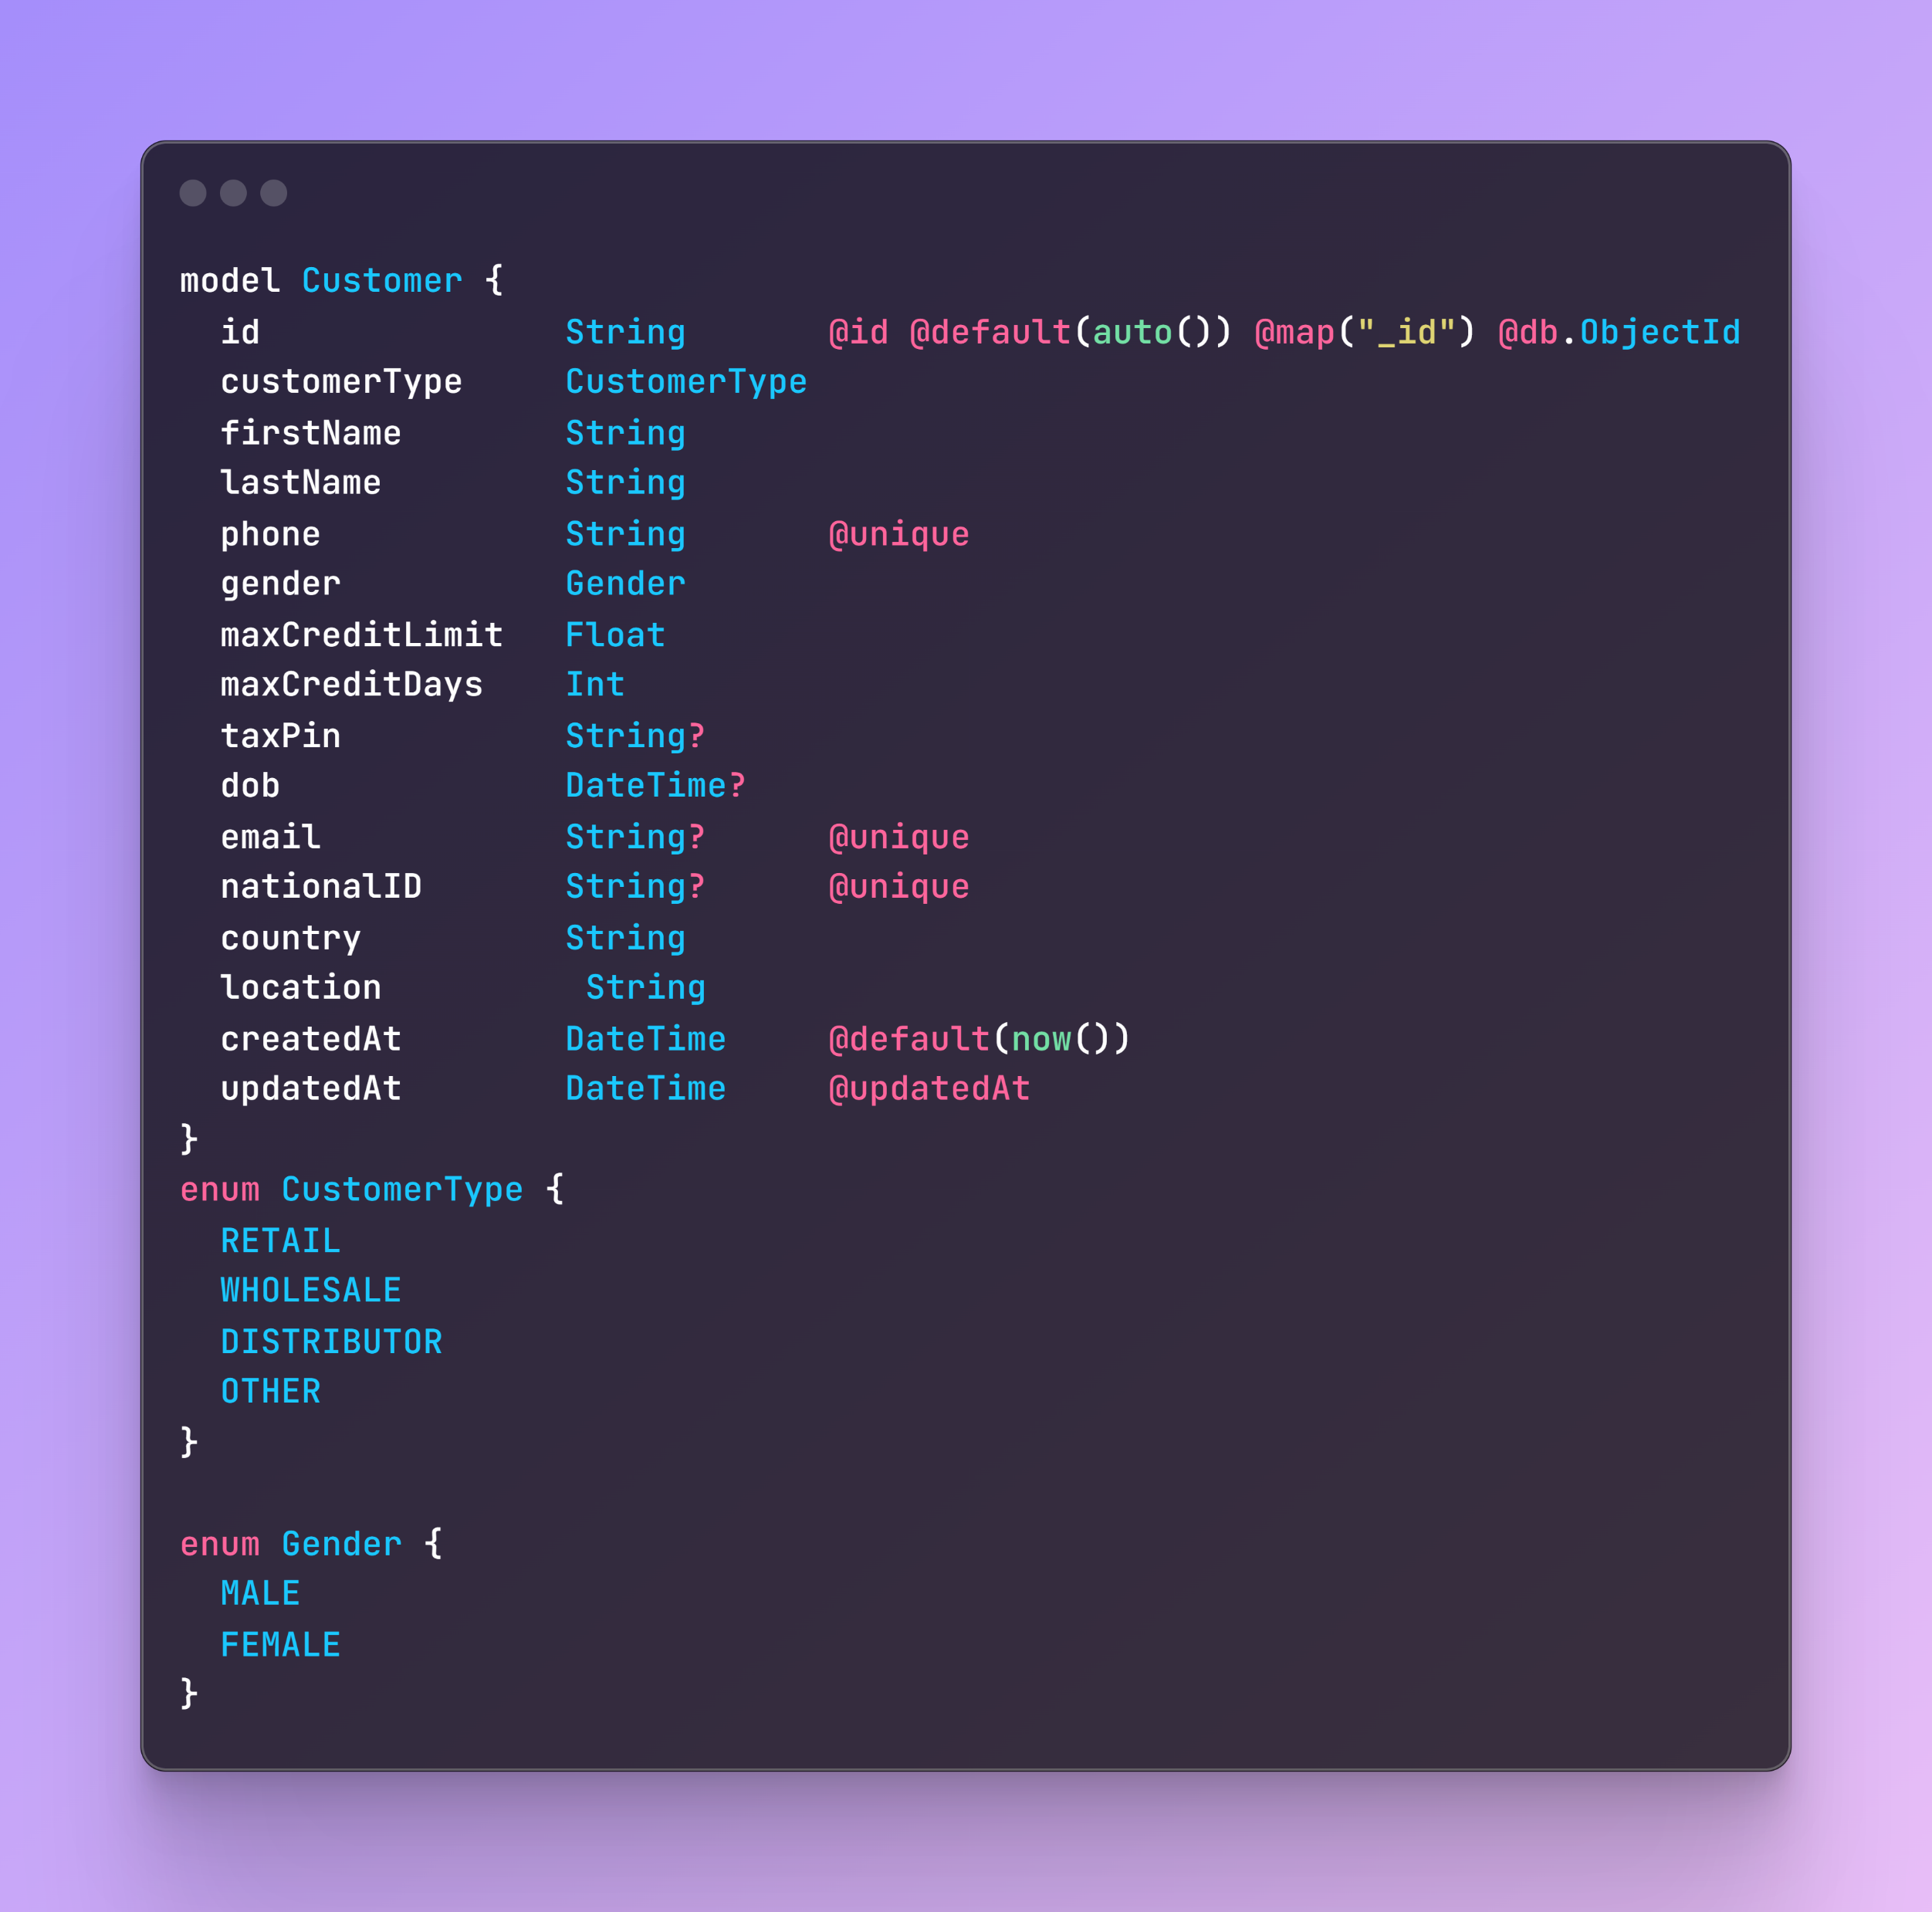
CUSTOMER MODEL

Slide 27
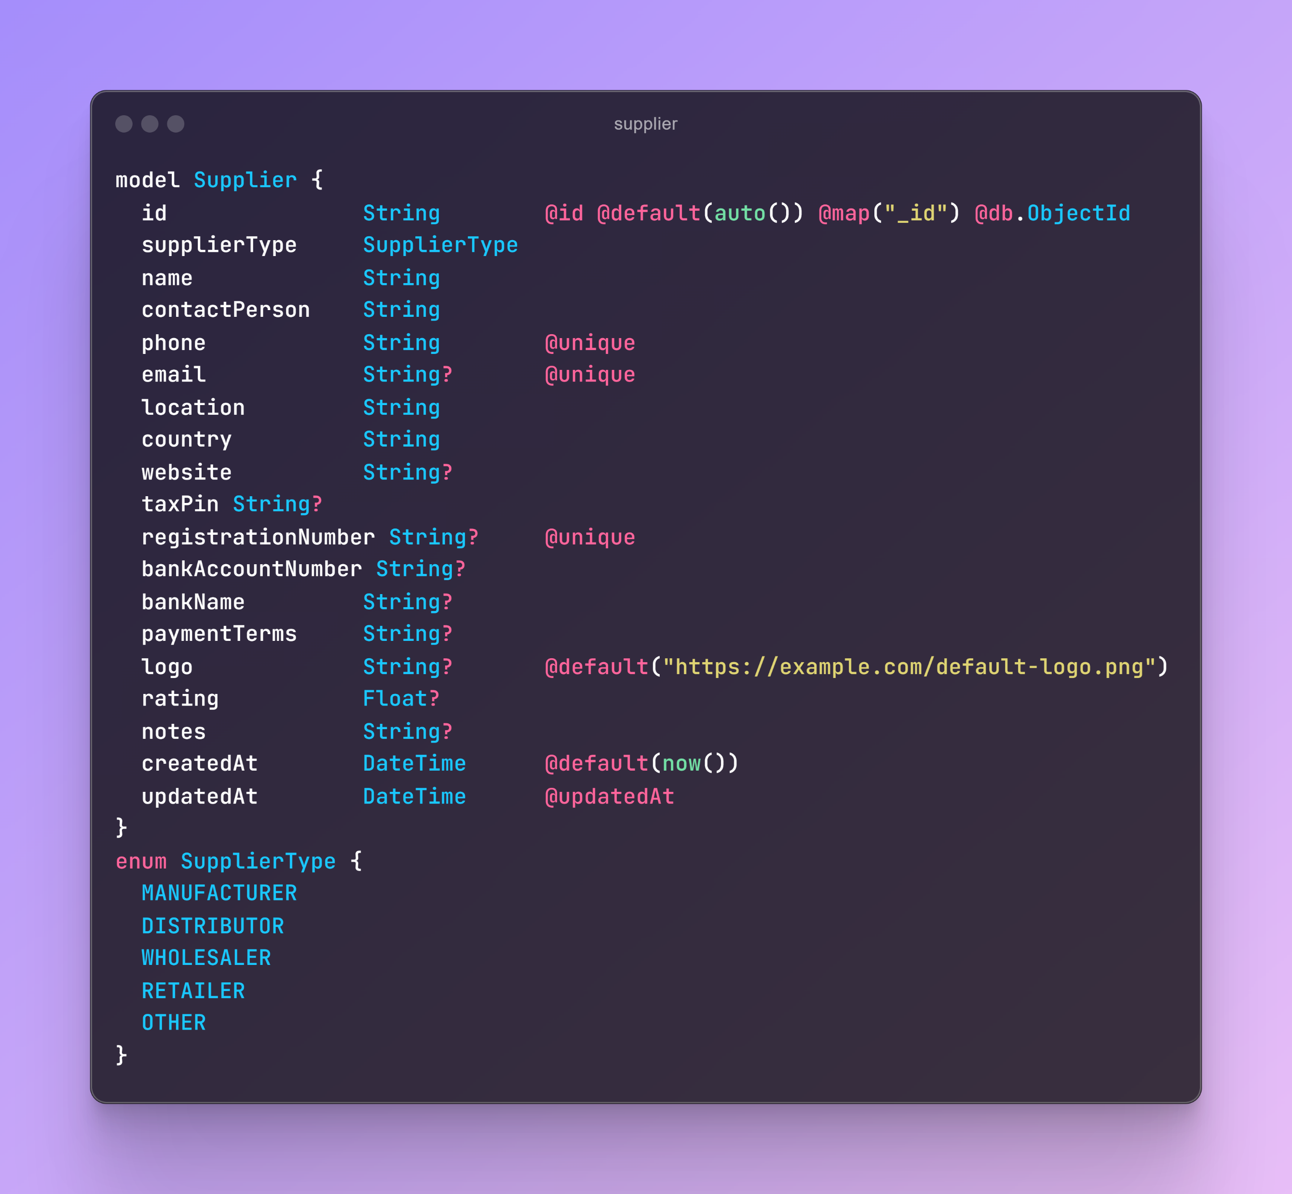
SUPPLIER MODEL

Slide 28
Authentication: Register and Login
1. Register (Sign Up):
Definition: Registration is the process where a new user creates an account in a system by providing their credentials and other required information. This process typically involves collecting data like a username, email address, password, and possibly other details like name or phone number.
Purpose:
User Identity Creation: Registering creates a new, unique user identity in the system. The system stores the user's credentials securely in a database.
Credential Storage: The password is usually hashed (encrypted) before storage to ensure security.
Account Activation: Some systems may also require email verification or other steps to activate the account.

Slide 29
Authentication: Register and Login
2. Login (Sign In):
Definition: Login is the process where a registered user provides their credentials (e.g., username/email and password) to gain access to their account. This process involves verifying the provided credentials against those stored in the system.
Purpose:
Identity Verification: The login process ensures that the user is who they claim to be by checking their credentials.
Access Granting: Once verified, the user is granted access to the system and its protected resources. This might involve generating a session or an authentication token (like a JWT) that the user will use in subsequent requests.

Slide 30
AUTHENTICATION (LOGIN )
For a Tech Person:
Authentication is the process of verifying the identity of a user or system. It involves checking credentials such as a username and password, biometric data, or tokens against a database to ensure that the entity attempting to access a system or resource is indeed who they claim to be.
For a Non-Tech Person:
Authentication is like showing your ID to get into a secured building. It's the way a system checks that you are who you say you are before letting you in.

Slide 31
AUTHORIZATION
For a Tech Person:
Authorization is the process of determining what actions, resources, or services a user or system is permitted to access after their identity has been authenticated. It involves enforcing access controls based on roles, permissions, or other policies.
For a Non-Tech Person:
Authorization is like having a key that only opens certain doors in a building. Even after you've shown your ID, the system decides what you're allowed to do or see based on the permissions you have.

Slide 32
AUTHENTICATION FLOW
Crate Login Api and Implement JWT Authentication api = '/auth/login'
Get The User Data From Body .
destructure the information from user.
Check the (email/user) exist in database or not .
if there is not any user with the email we send user not found.
if the (user) exist in database we will check the password is valid or not .
compare the password in database and the password in the request body.
if not matched send response that wrong password.
if the email and password is valid create a token .
To create a token JsonWebToken (JWT) receive's 3 parameter
Payload - This contains the claims or data you want to include in the token.
Secret Key - A secure key known only to the server used for signing the token.
expiration - Additional settings like token expiration or algorithm selection.
Don't Provide the secret openly, This secret is very sensitive for the server . keep it in the .env file. Use this command to generate a strong key : openssl rand -base64 32
After creating the token send the response.

Slide 33
WHAT IS JWT and ITS PURPOSE
JWT (JSON Web Token) is a compact, URL-safe token format that is used for securely transmitting information between parties as a JSON object. It is composed of three parts: a header, a payload, and a signature, which are encoded as Base64 strings and concatenated with periods.
Header: Contains metadata about the token, such as the type (JWT) and the hashing algorithm used (e.g., HS256).
Payload: Contains the claims or data you want to transmit, such as user information (e.g., user ID, roles) or other relevant information.
Signature: A cryptographic signature generated using a secret key (and the specified hashing algorithm), which ensures the token's integrity and authenticity.

Slide 34
WHAT IS JWT and ITS PURPOSE
What is its Purpose?
The primary purpose of JWT is to securely transfer information between two parties. It's commonly used for:
Authentication: JWTs are often used as access tokens in authentication systems. Once a user logs in and their identity is verified, the server generates a JWT and sends it back to the client. The client then includes this token in subsequent requests to access protected resources, and the server verifies the token to ensure the request is from an authenticated user.
Authorization: JWTs can also carry information about user permissions and roles. After authentication, the JWT can be used to authorize access to specific resources or actions based on the encoded data in the payload.
Stateless Sessions: JWT allows for stateless authentication, meaning the server does not need to store session information. The information is encoded directly in the token and can be verified and decoded by the server for each request. This makes JWT ideal for scalable, distributed systems.

Slide 35
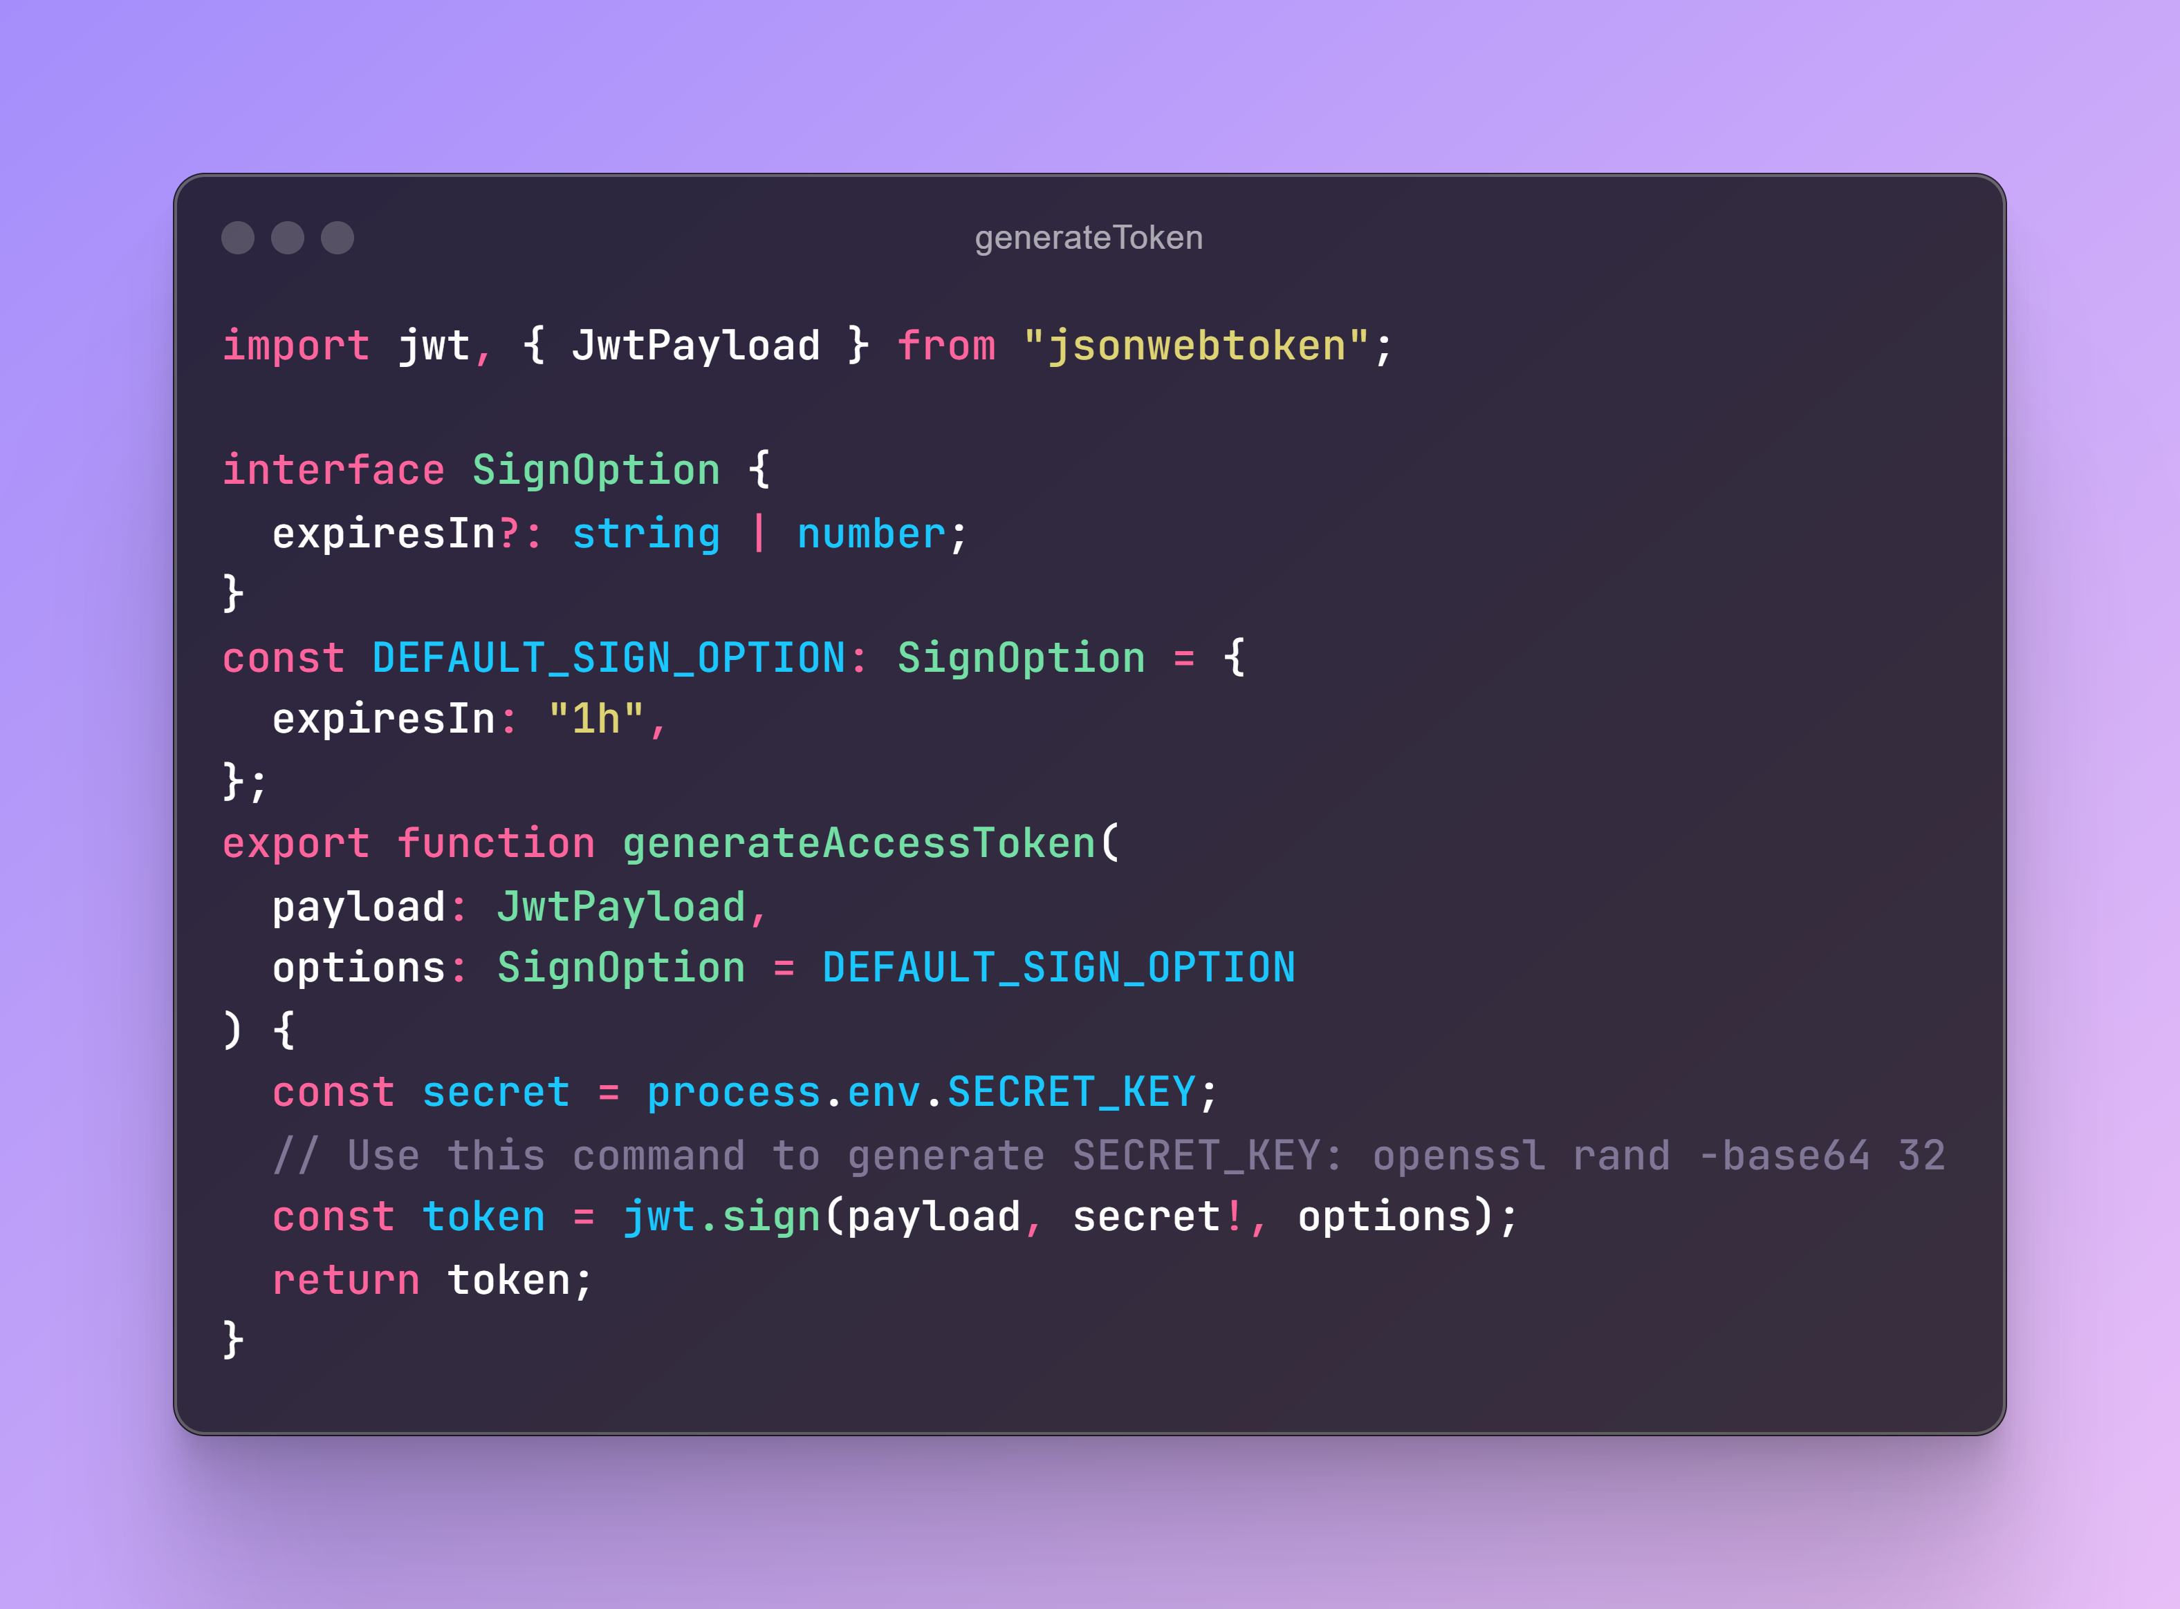
Generate JWT

Slide 36
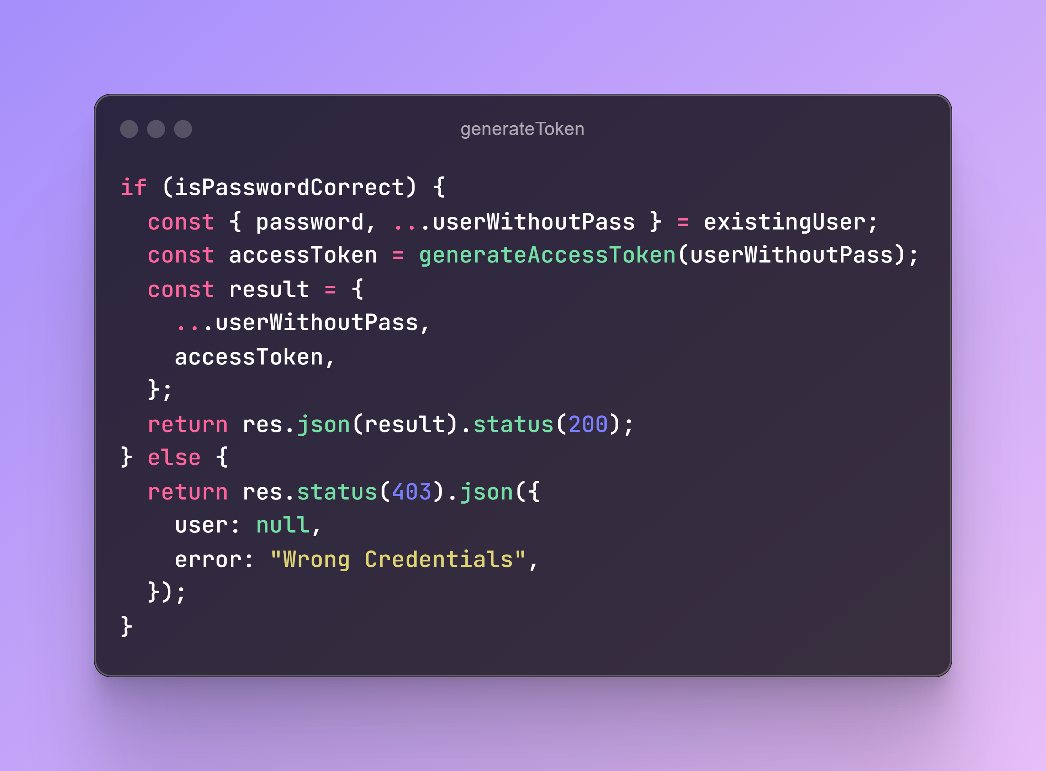
Return access token to the Logged in User

Slide 37
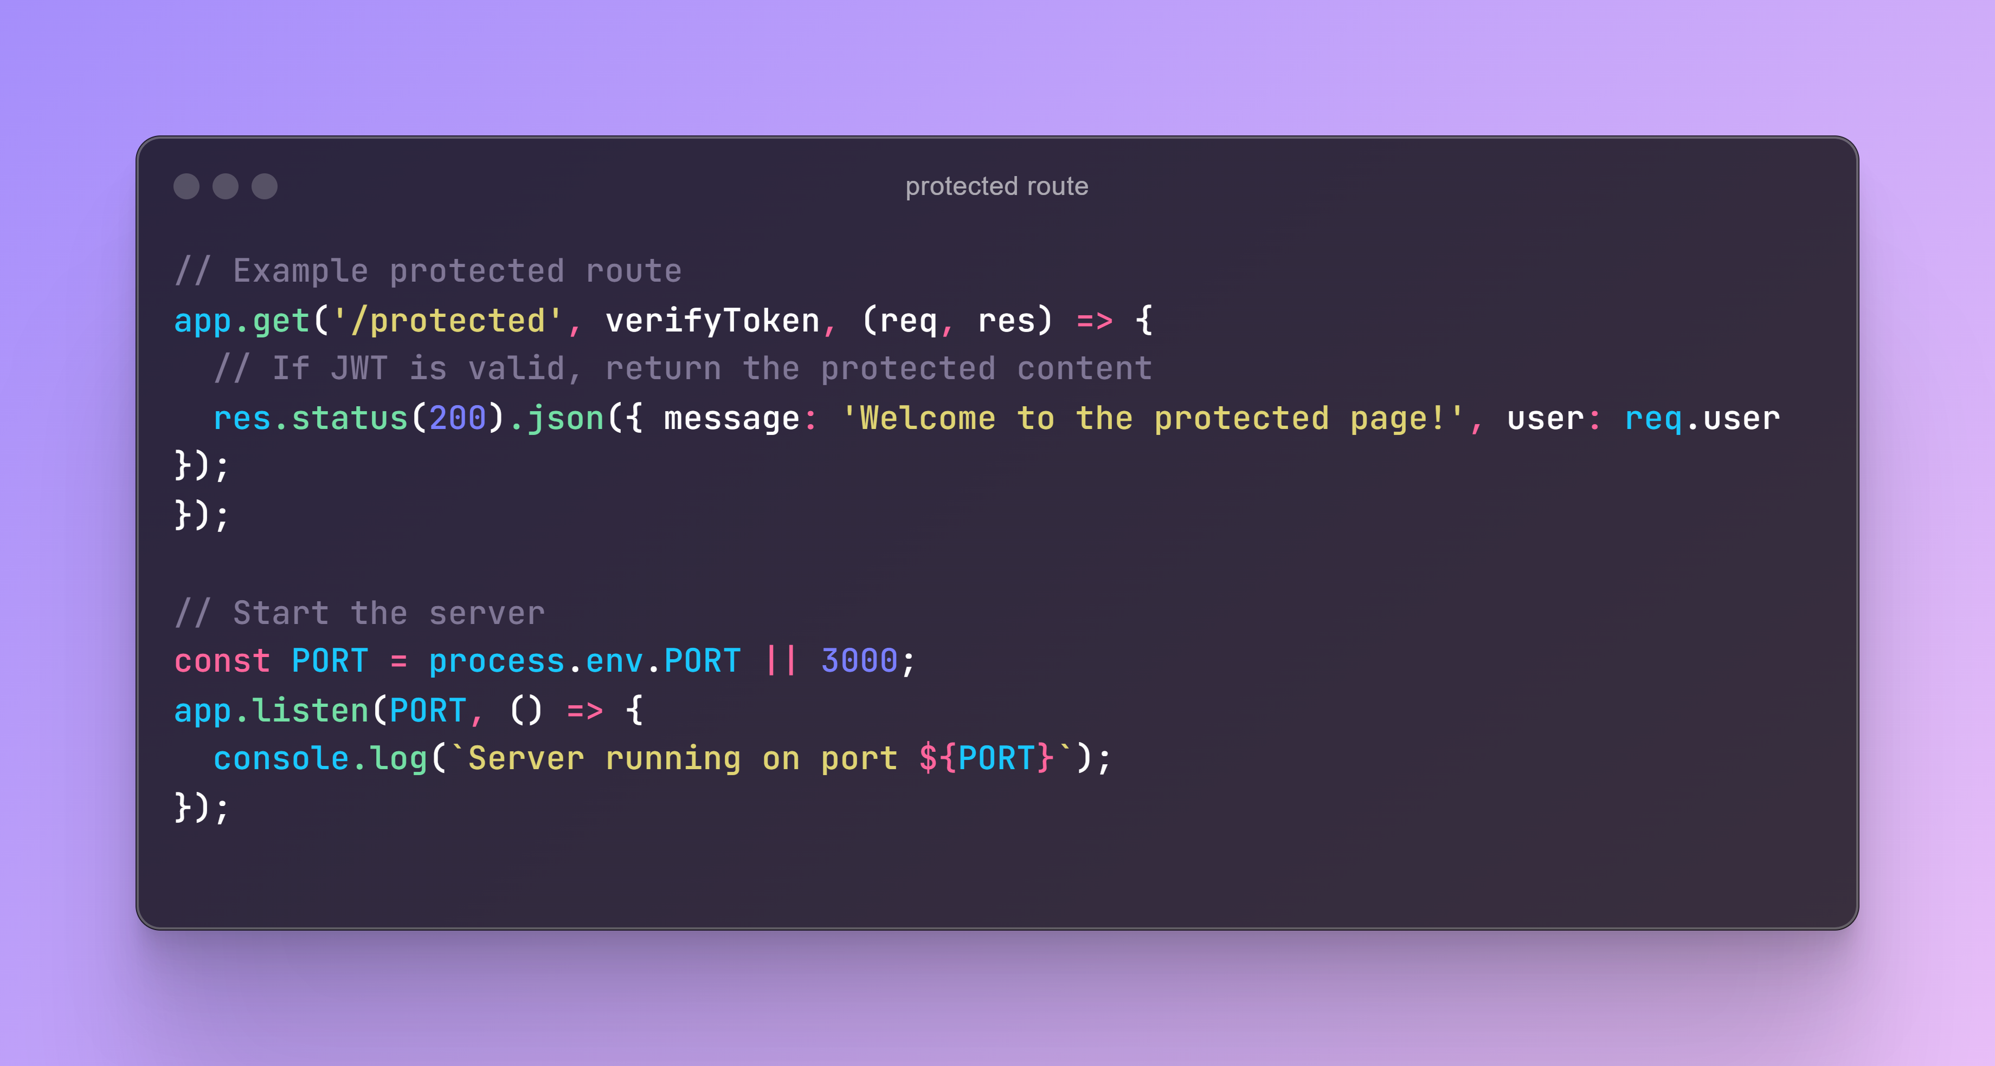
Protect a route with JWT when a user tries to access a route

Slide 38
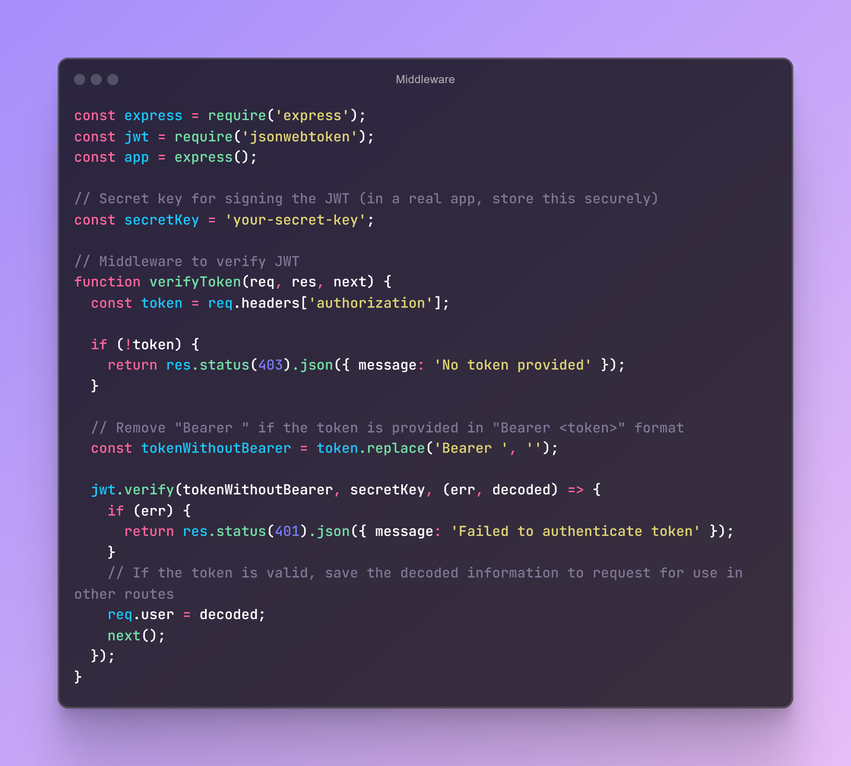
Middleware to verify the token

Slide 39
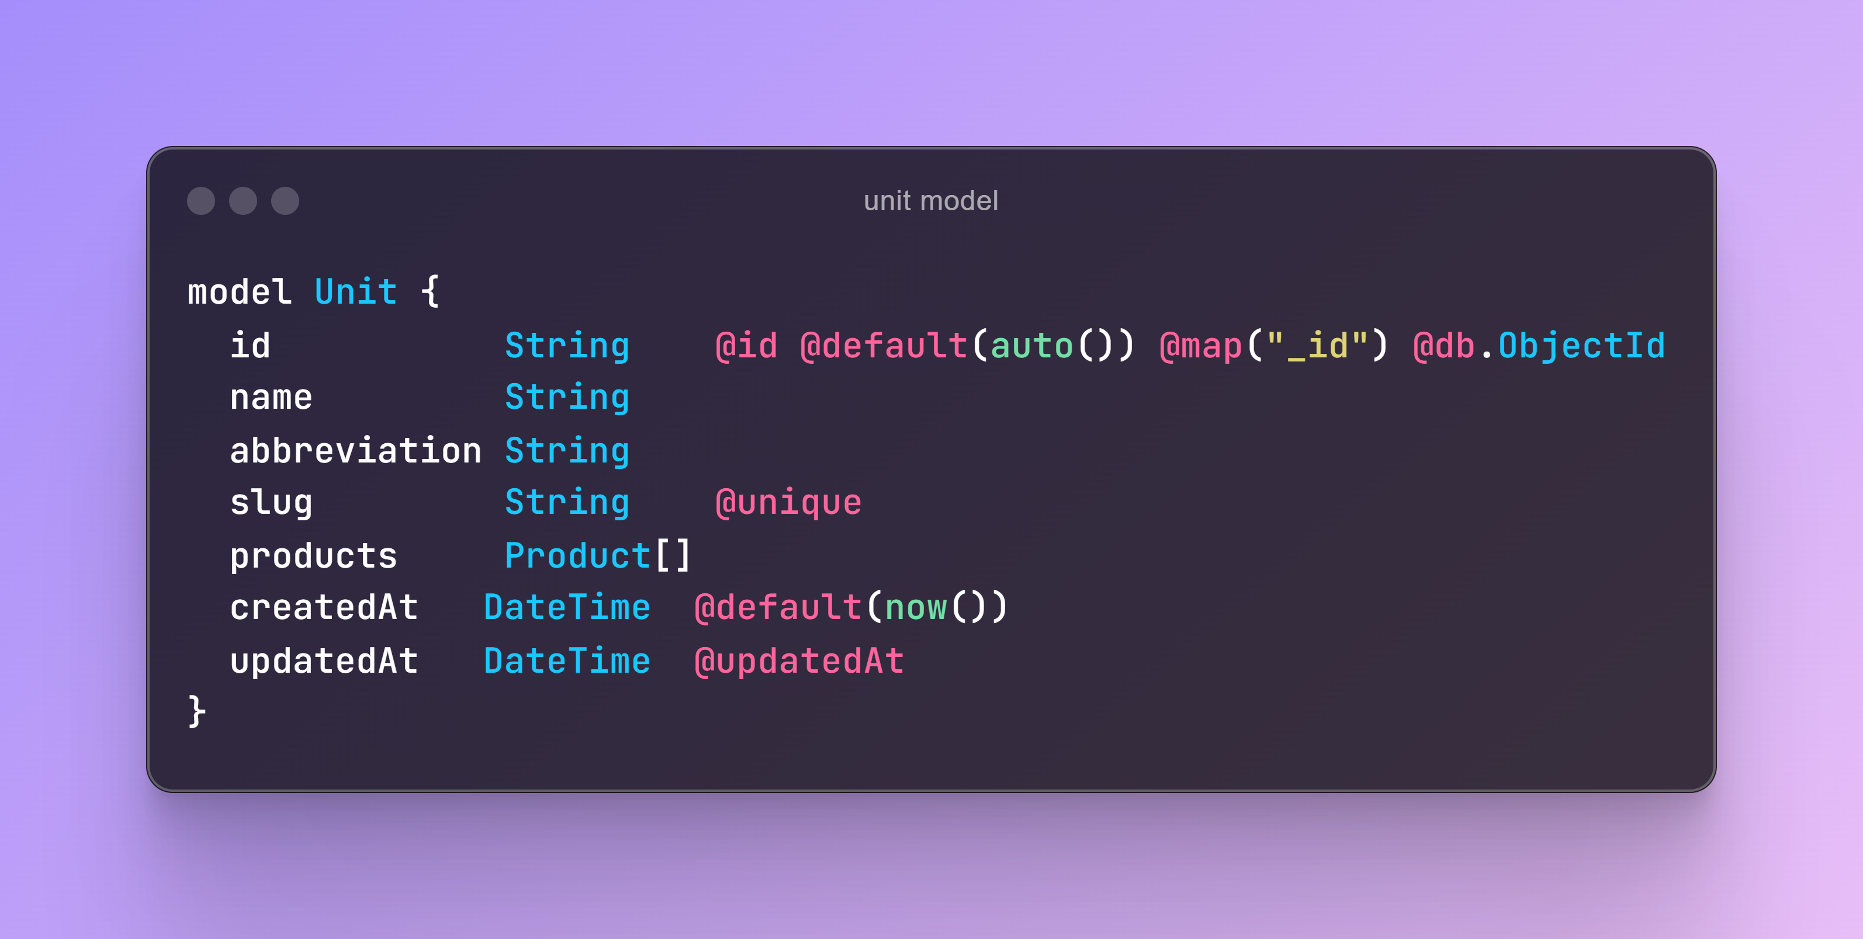
UNIT MODEL

Slide 40
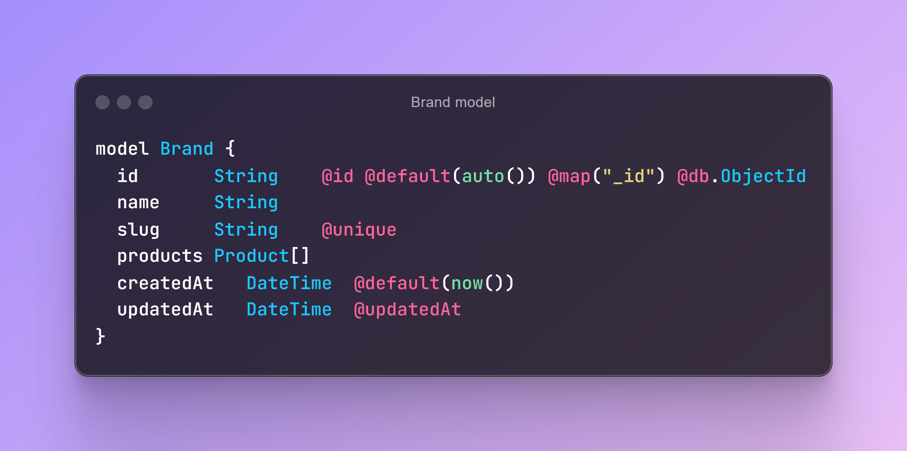
BRAND MODEL

Slide 41
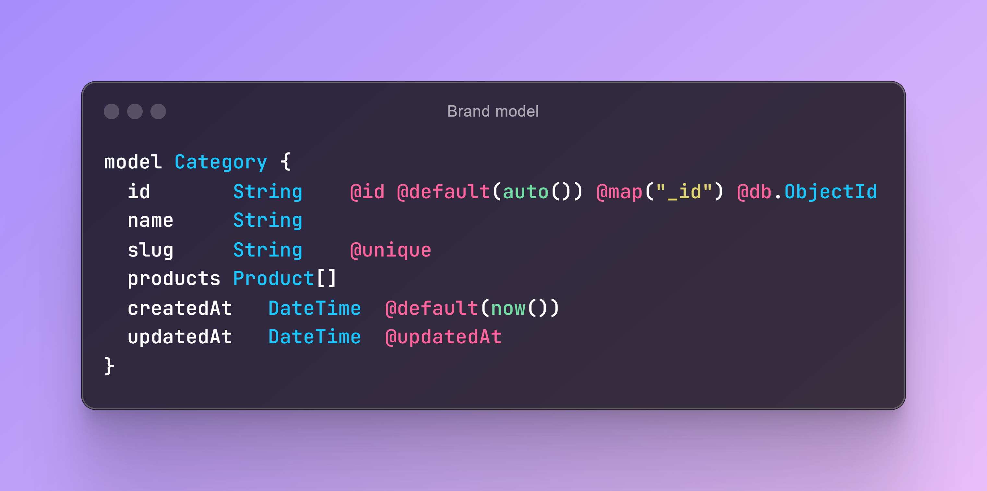
CATEGORY MODEL

Slide 42
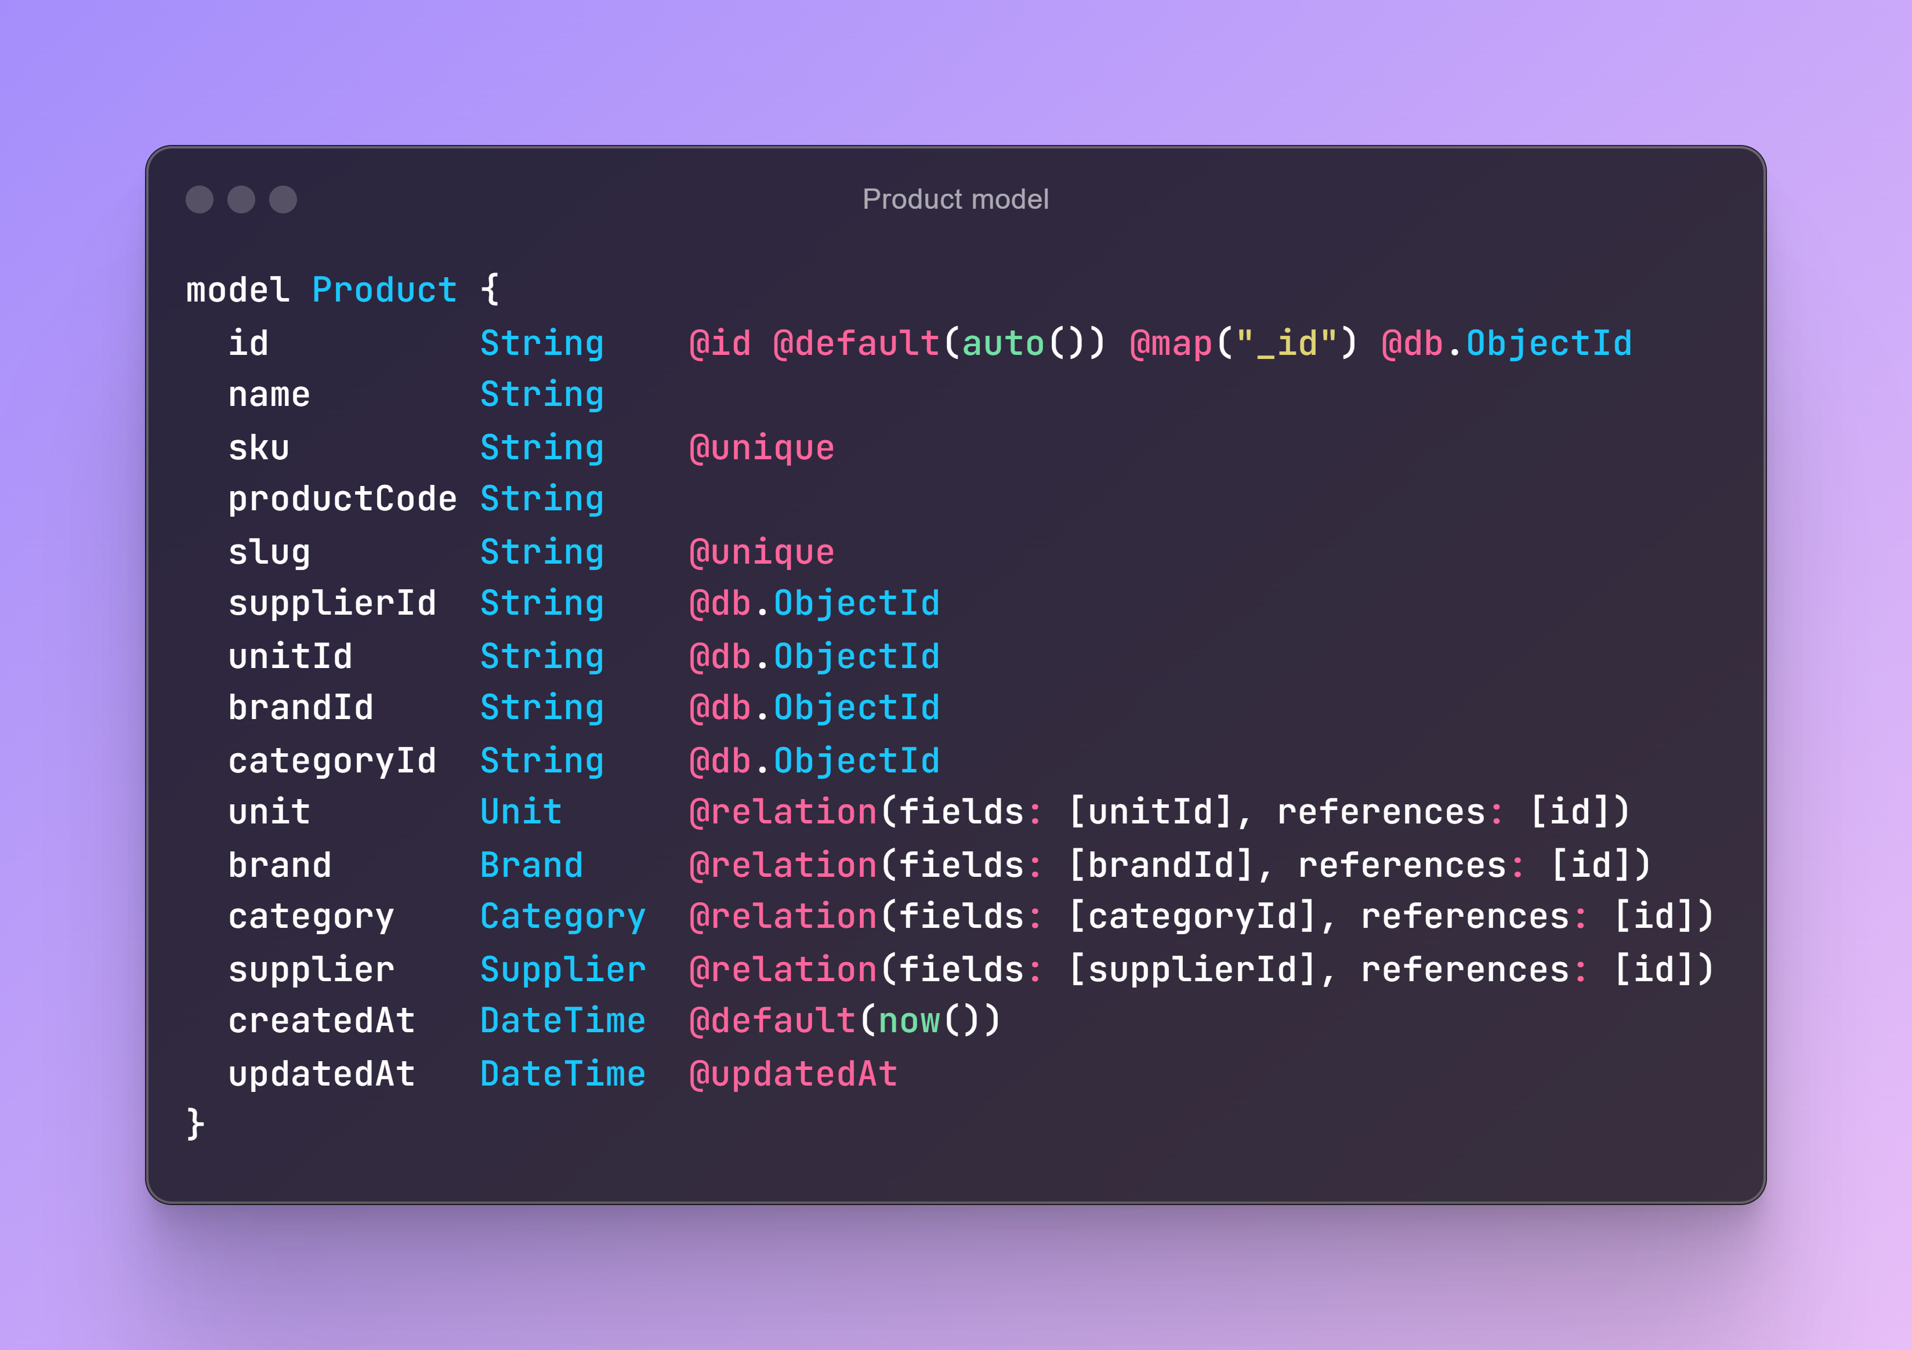
PRODUCT MODEL

Slide 43
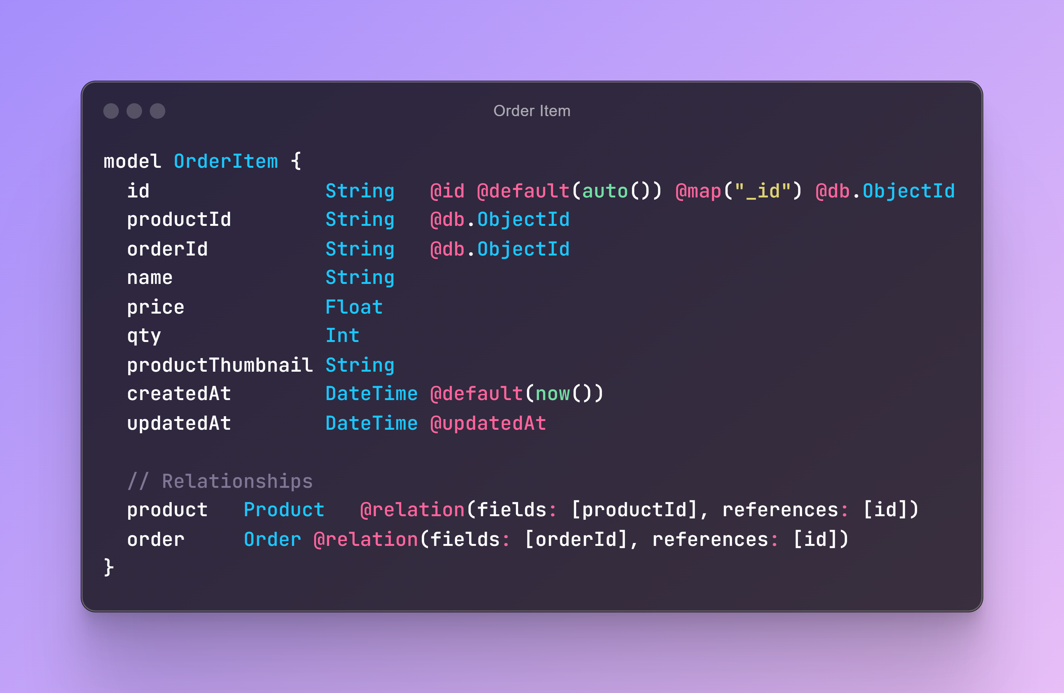
OrderItem MODEL

Slide 44
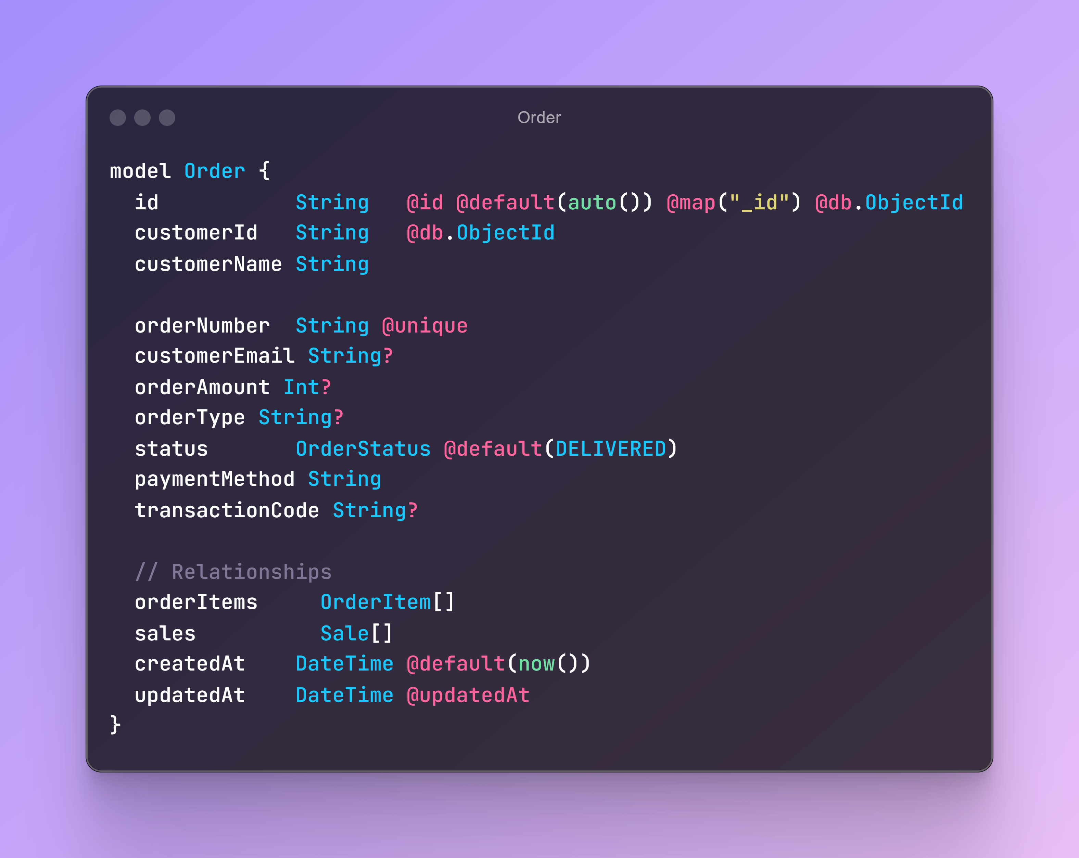
Order MODEL

Slide 45
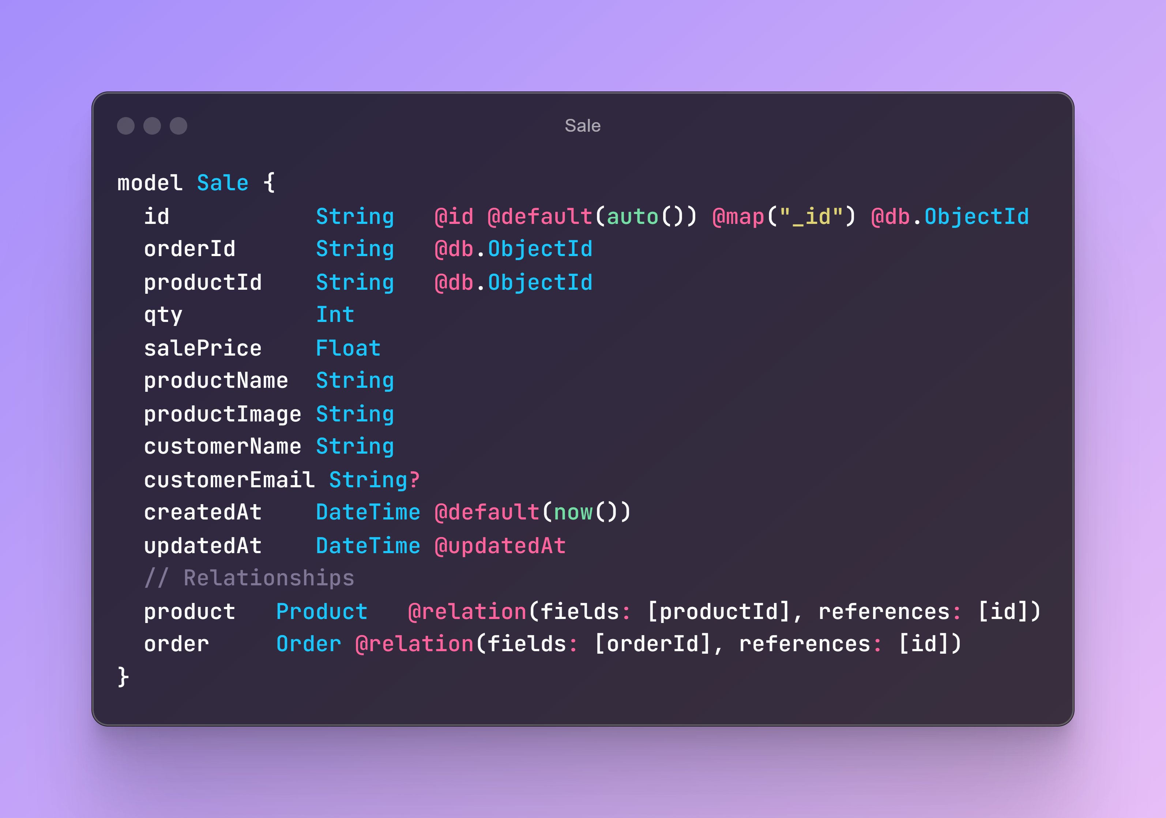
Sale MODEL

Slide 46
Sale MODEL

Slide 47
Forgot Password Routes
Forgot-Password Route:
Generate a secure token and store it in the resetToken field.
Set the resetTokenExpiry to a future date, e.g., 1 hour from the time of the request.
Send an email to the user with the reset token.
Verify-Token Route:
Check if the token exists and is valid.
Verify that the token has not expired by comparing the current date with resetTokenExpiry.
Change-Password Route:
Validate the token again.
Allow the user to change their password if the token is valid and not expired.
Clear the resetToken and resetTokenExpiry fields after the password is changed.

Slide 48
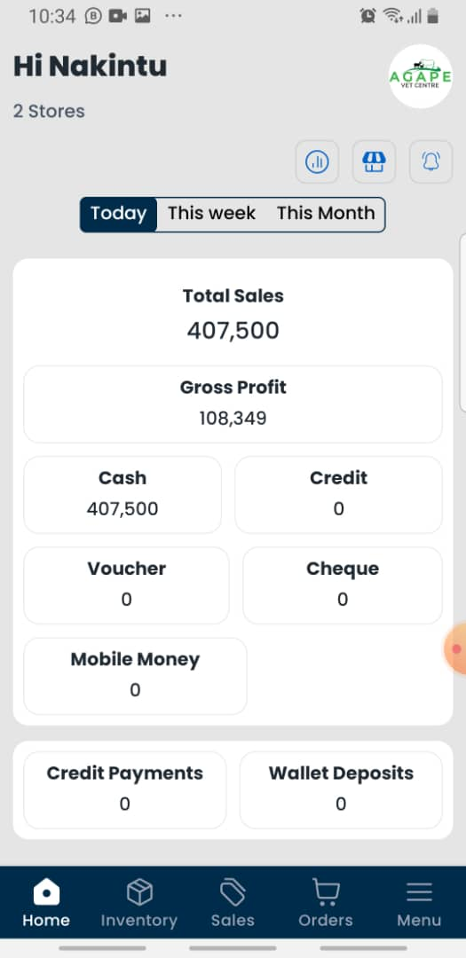
Sales Analytics
Sales Period
Sales Paid in Cash
Sales Paid in Credit
Sales in Mobile Money
Sales by Hand Cash

Slide 49
Advise
Tutorials
Learn and Build Unique
Weaknesses & Poor Routines
Help More
AI
Share your work

Slide 50
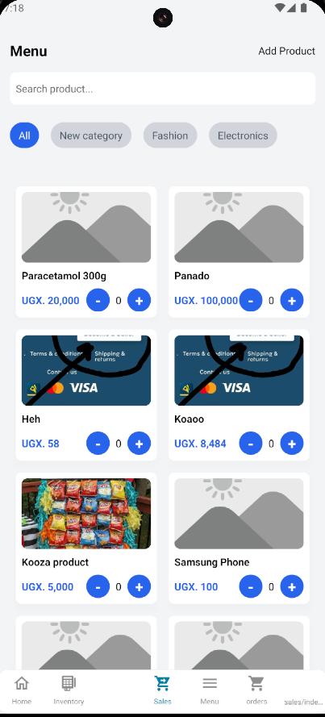
Mobile App Progress

Slide 51
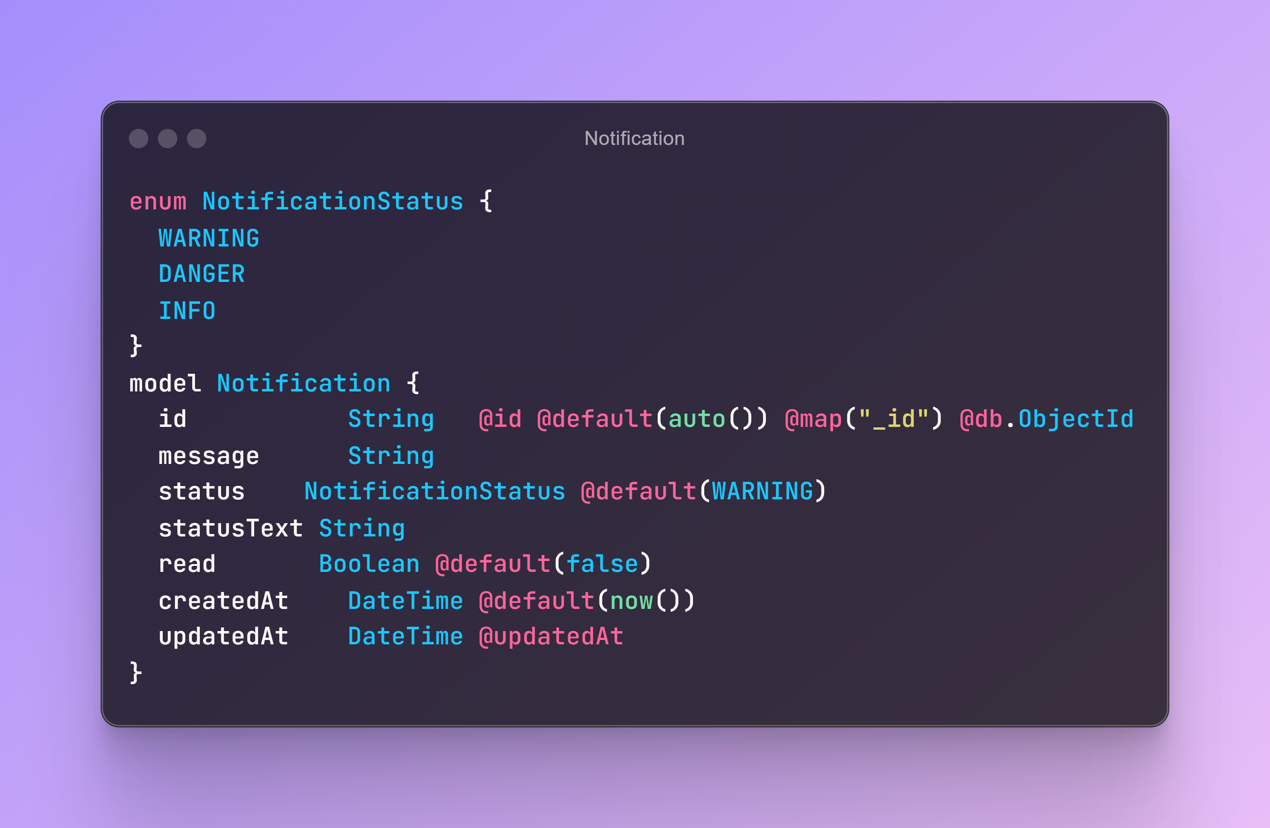
Notifications

Slide 52
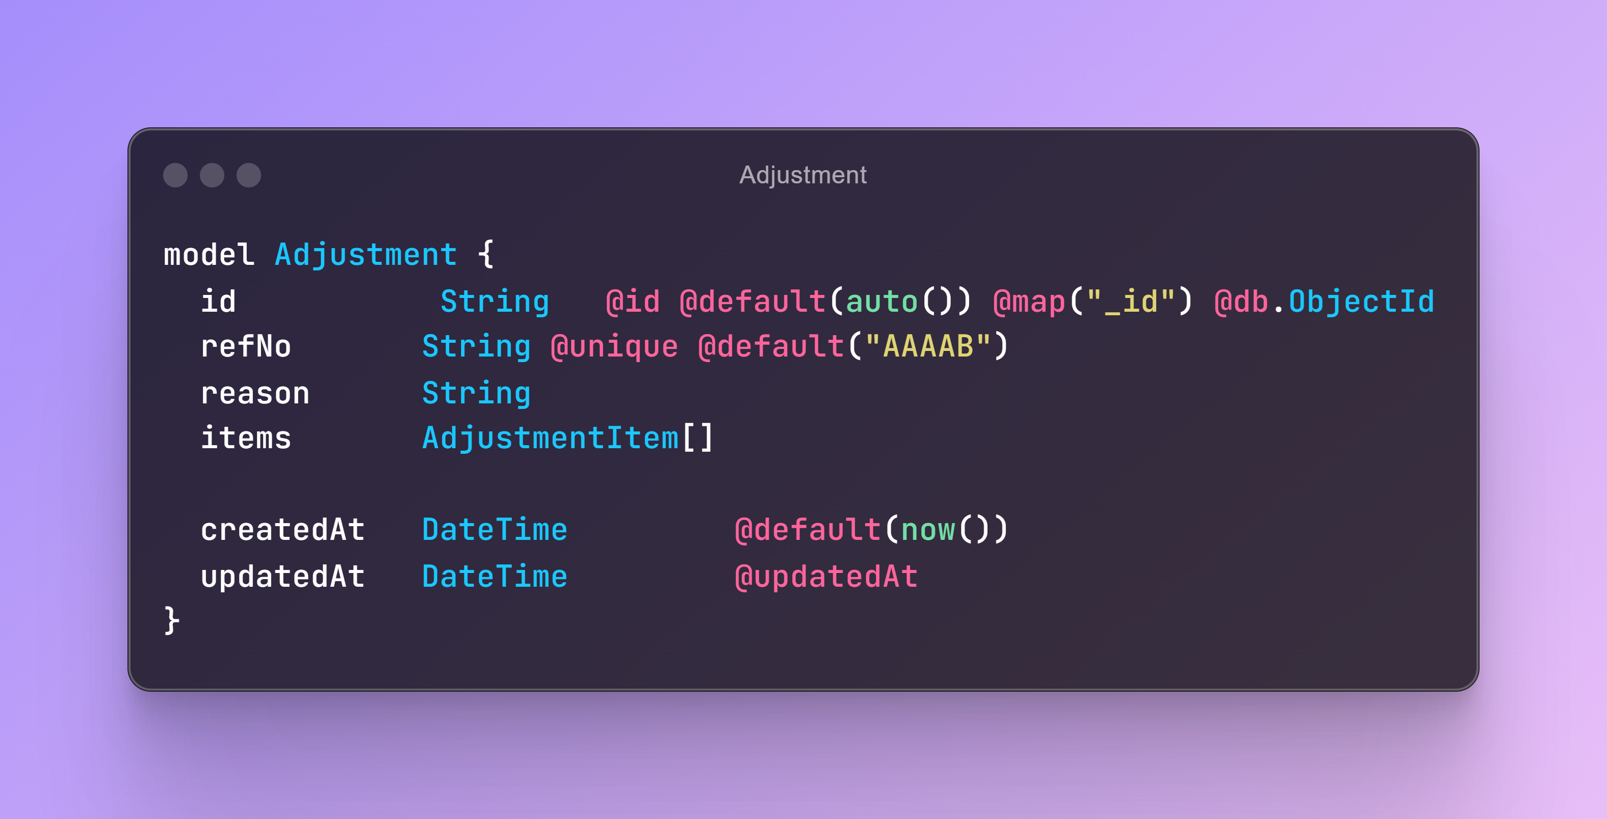
Adjustments

Slide 53
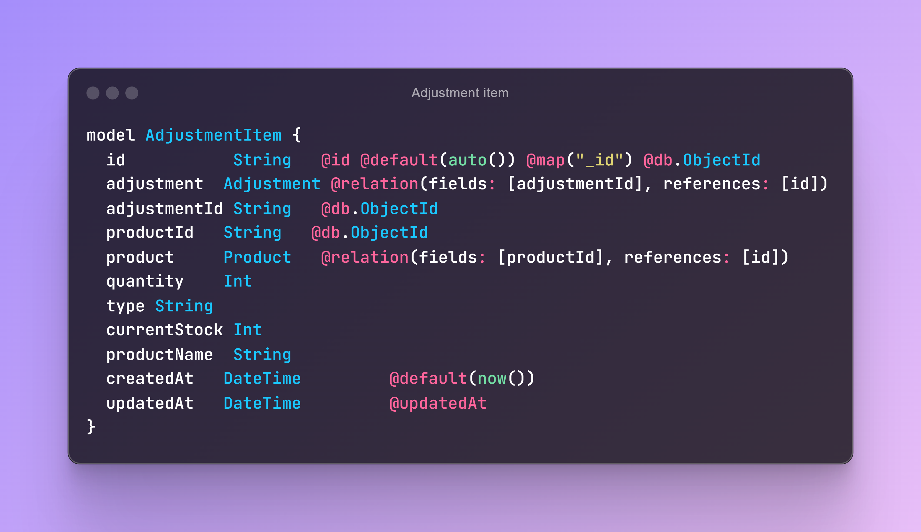
Adjustment Item

Slide 54
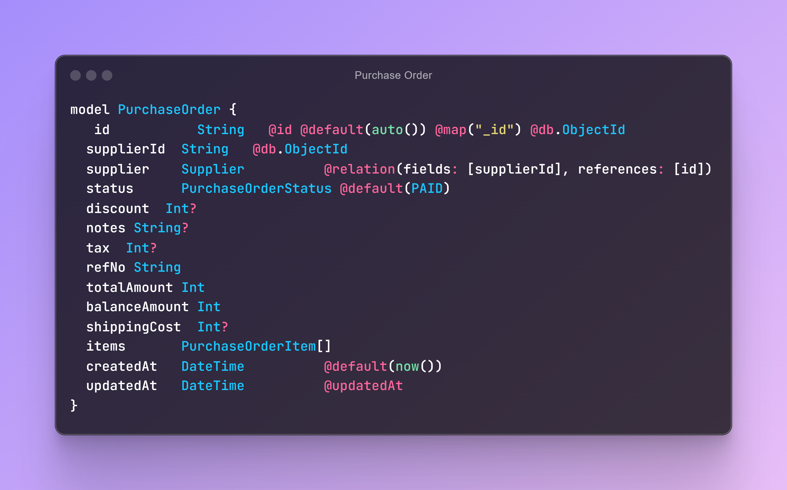
PurchaseOrder

Slide 55
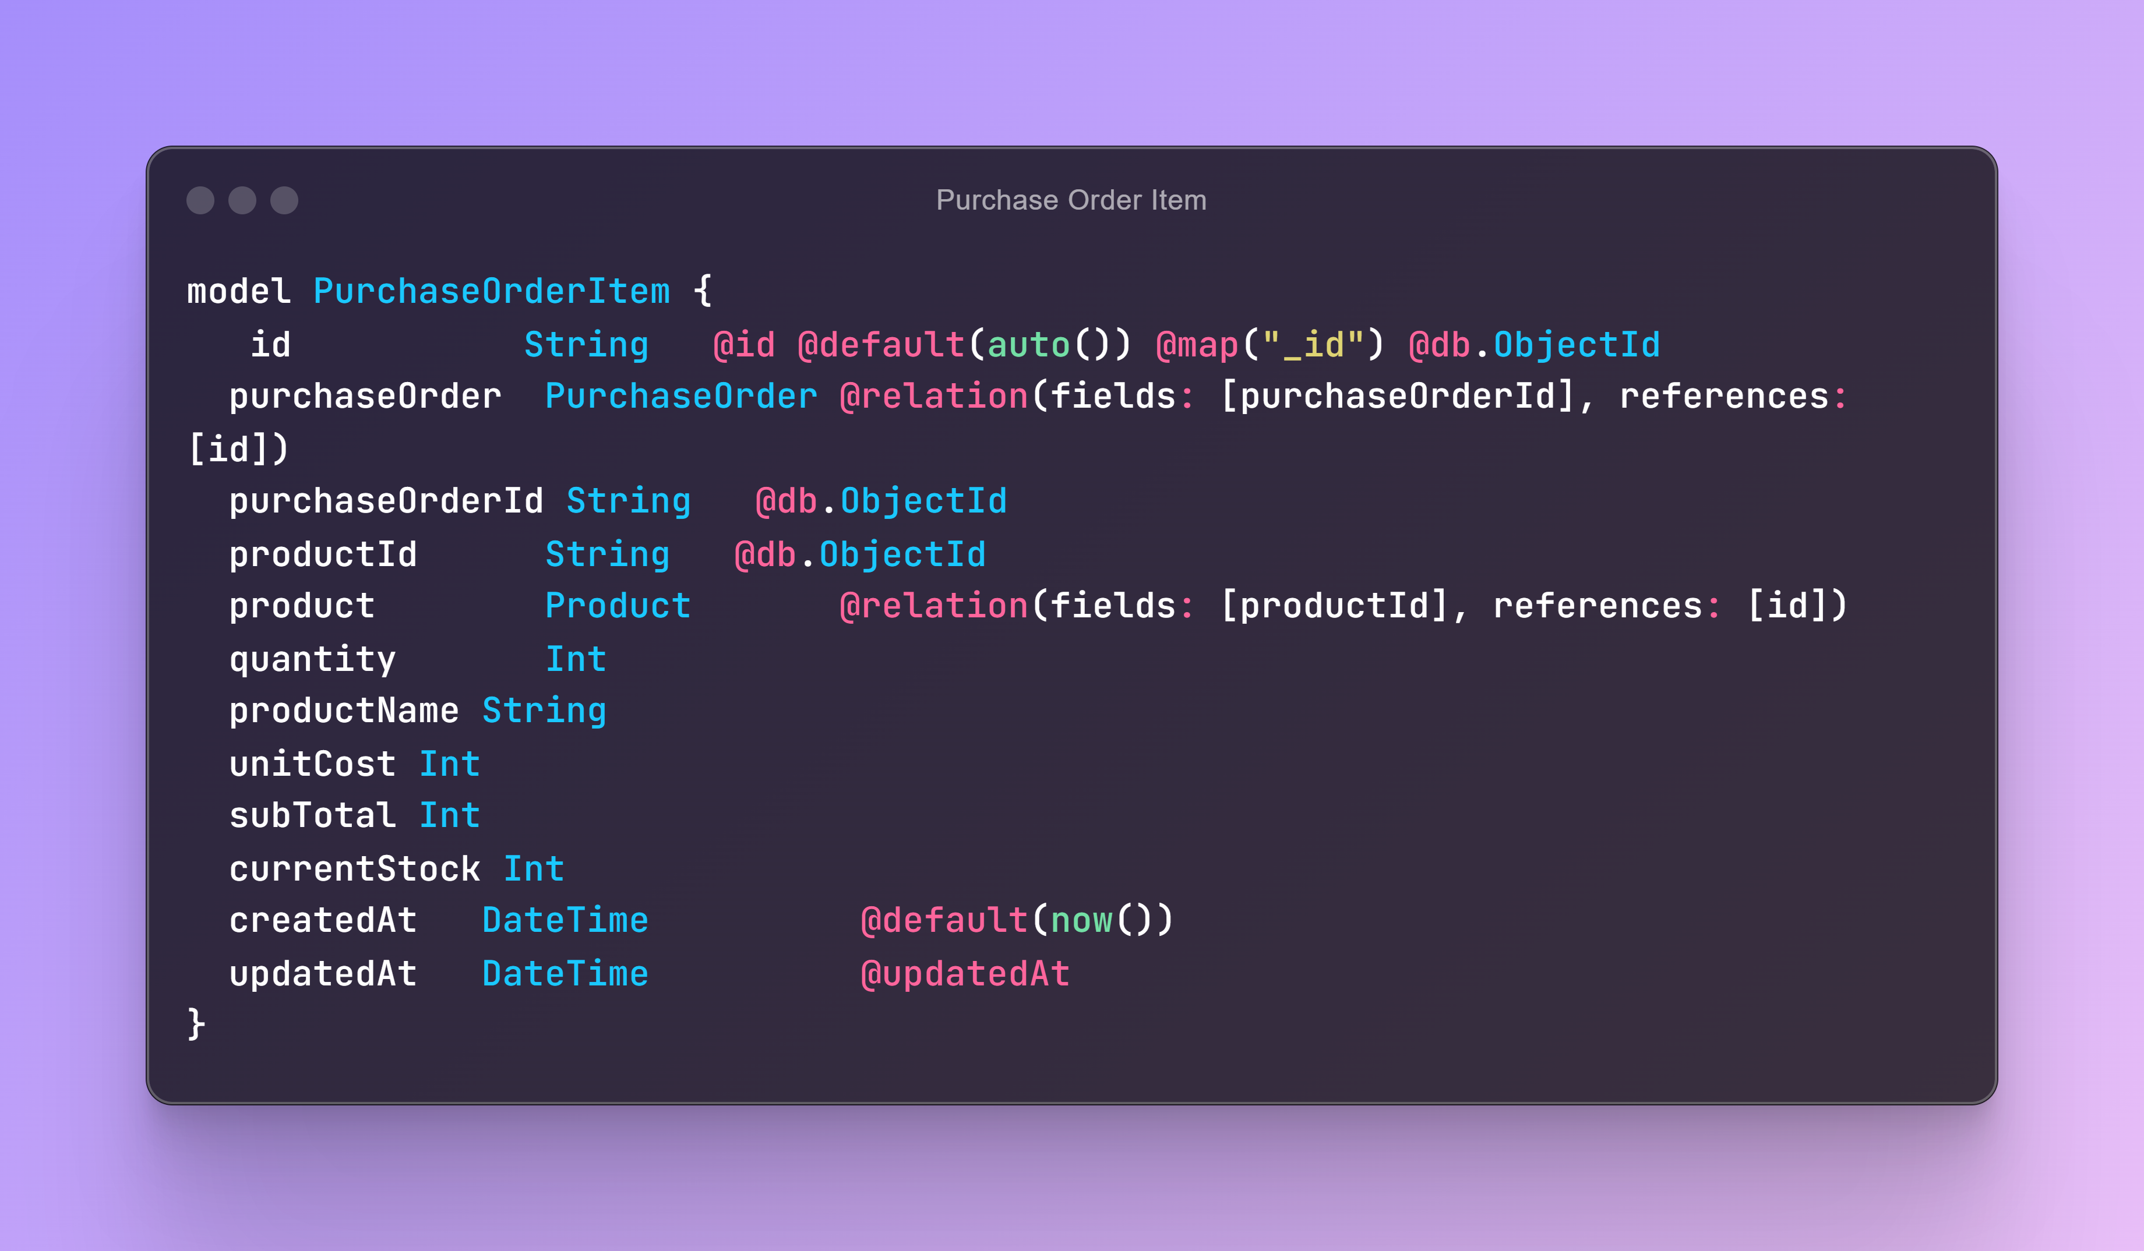
Purchase Order Item

